Slide 1



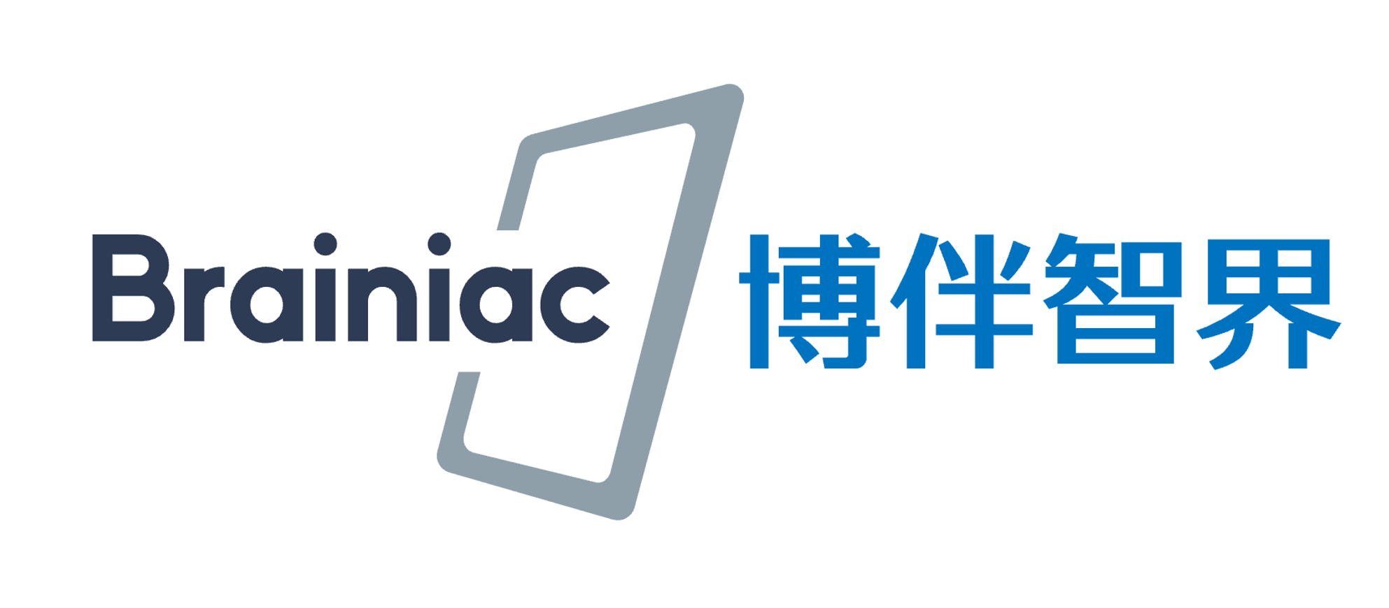

AI-Powered Math Education Practice at Peking University
PKU-Quest
Leheng Chen Zihao Liu
2025.9

Slide 2



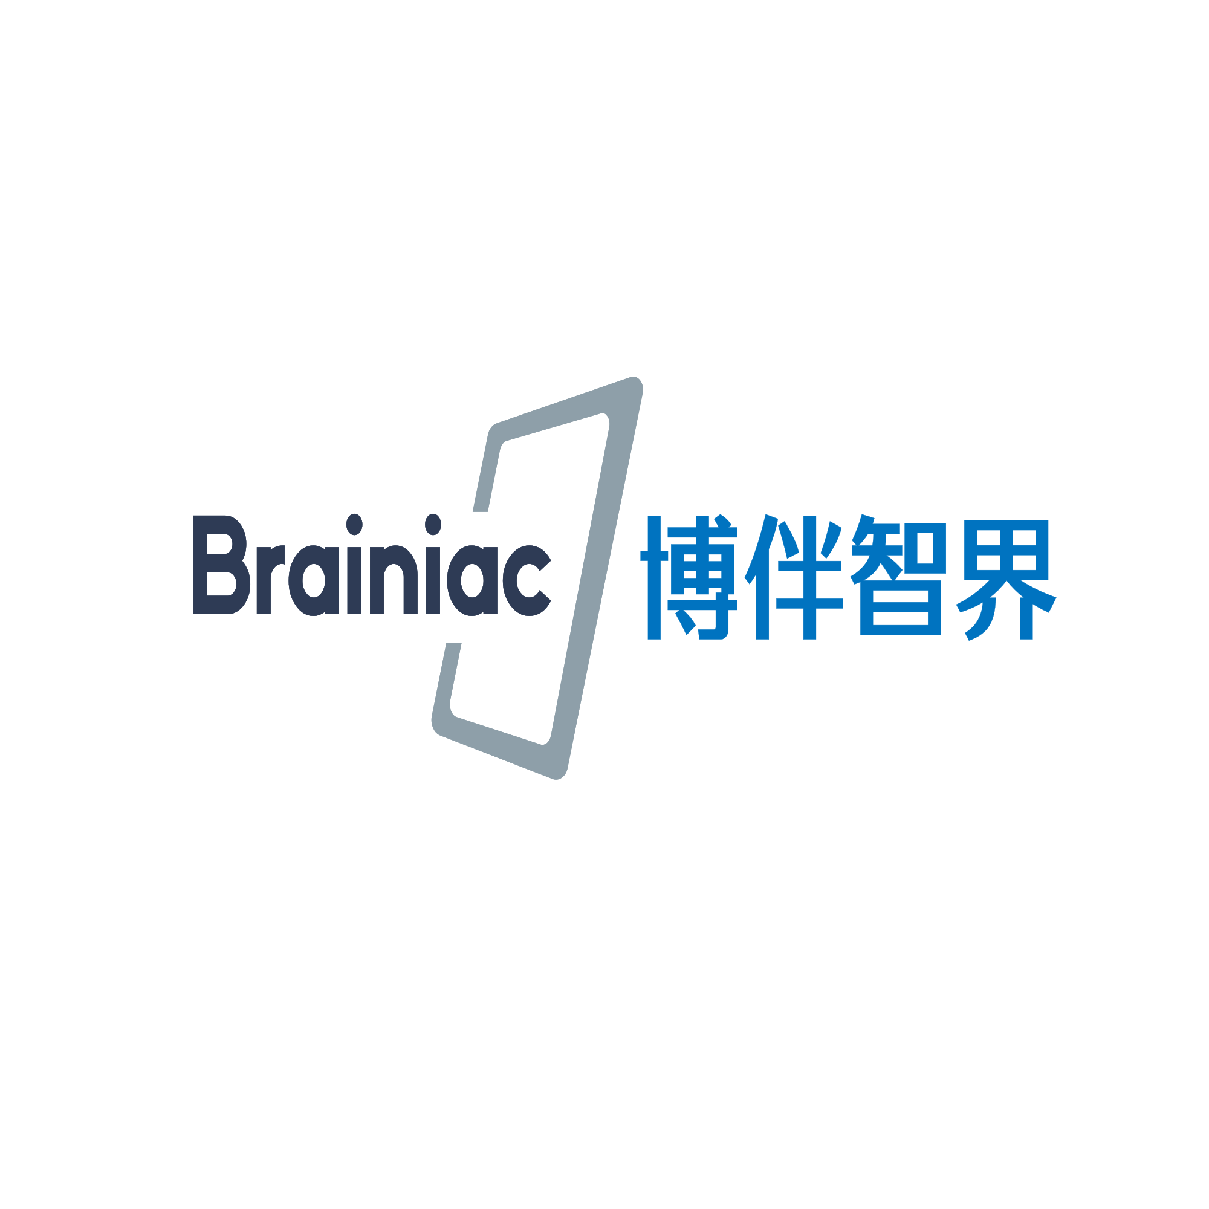
About Us
Leheng Chen
PhD Candidate in BICMR (PKU)
& Zhongguancun Academy
Gold Medalist, China Mathematical Olympiad
Focus: AI Engineering for Education Equity
Zihao Liu
PhD Candidate in BICMR (PKU)
& Zhongguancun Academy Initiator & early developer of the project
Focus: AI + Education Integration
Brainiac is an EdTech company originates from Peking University’s School of Mathematic science, leveraging AI and large models to enhance knowledge understanding, improve teaching processes, and reshape the education ecosystem.

Slide 3
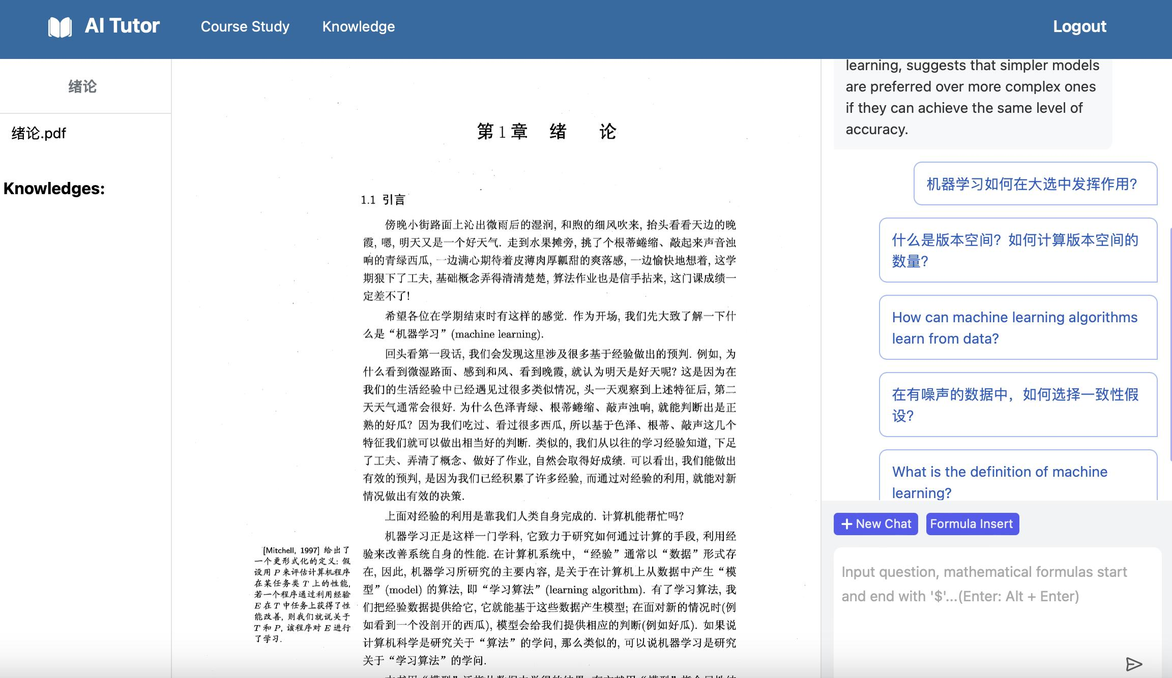
Project Milestones
September 2023–May 2024：First-generation product Brainiac Buddy launched — China’s earliest “AI + Education”(AITutor) applications.

Slide 4
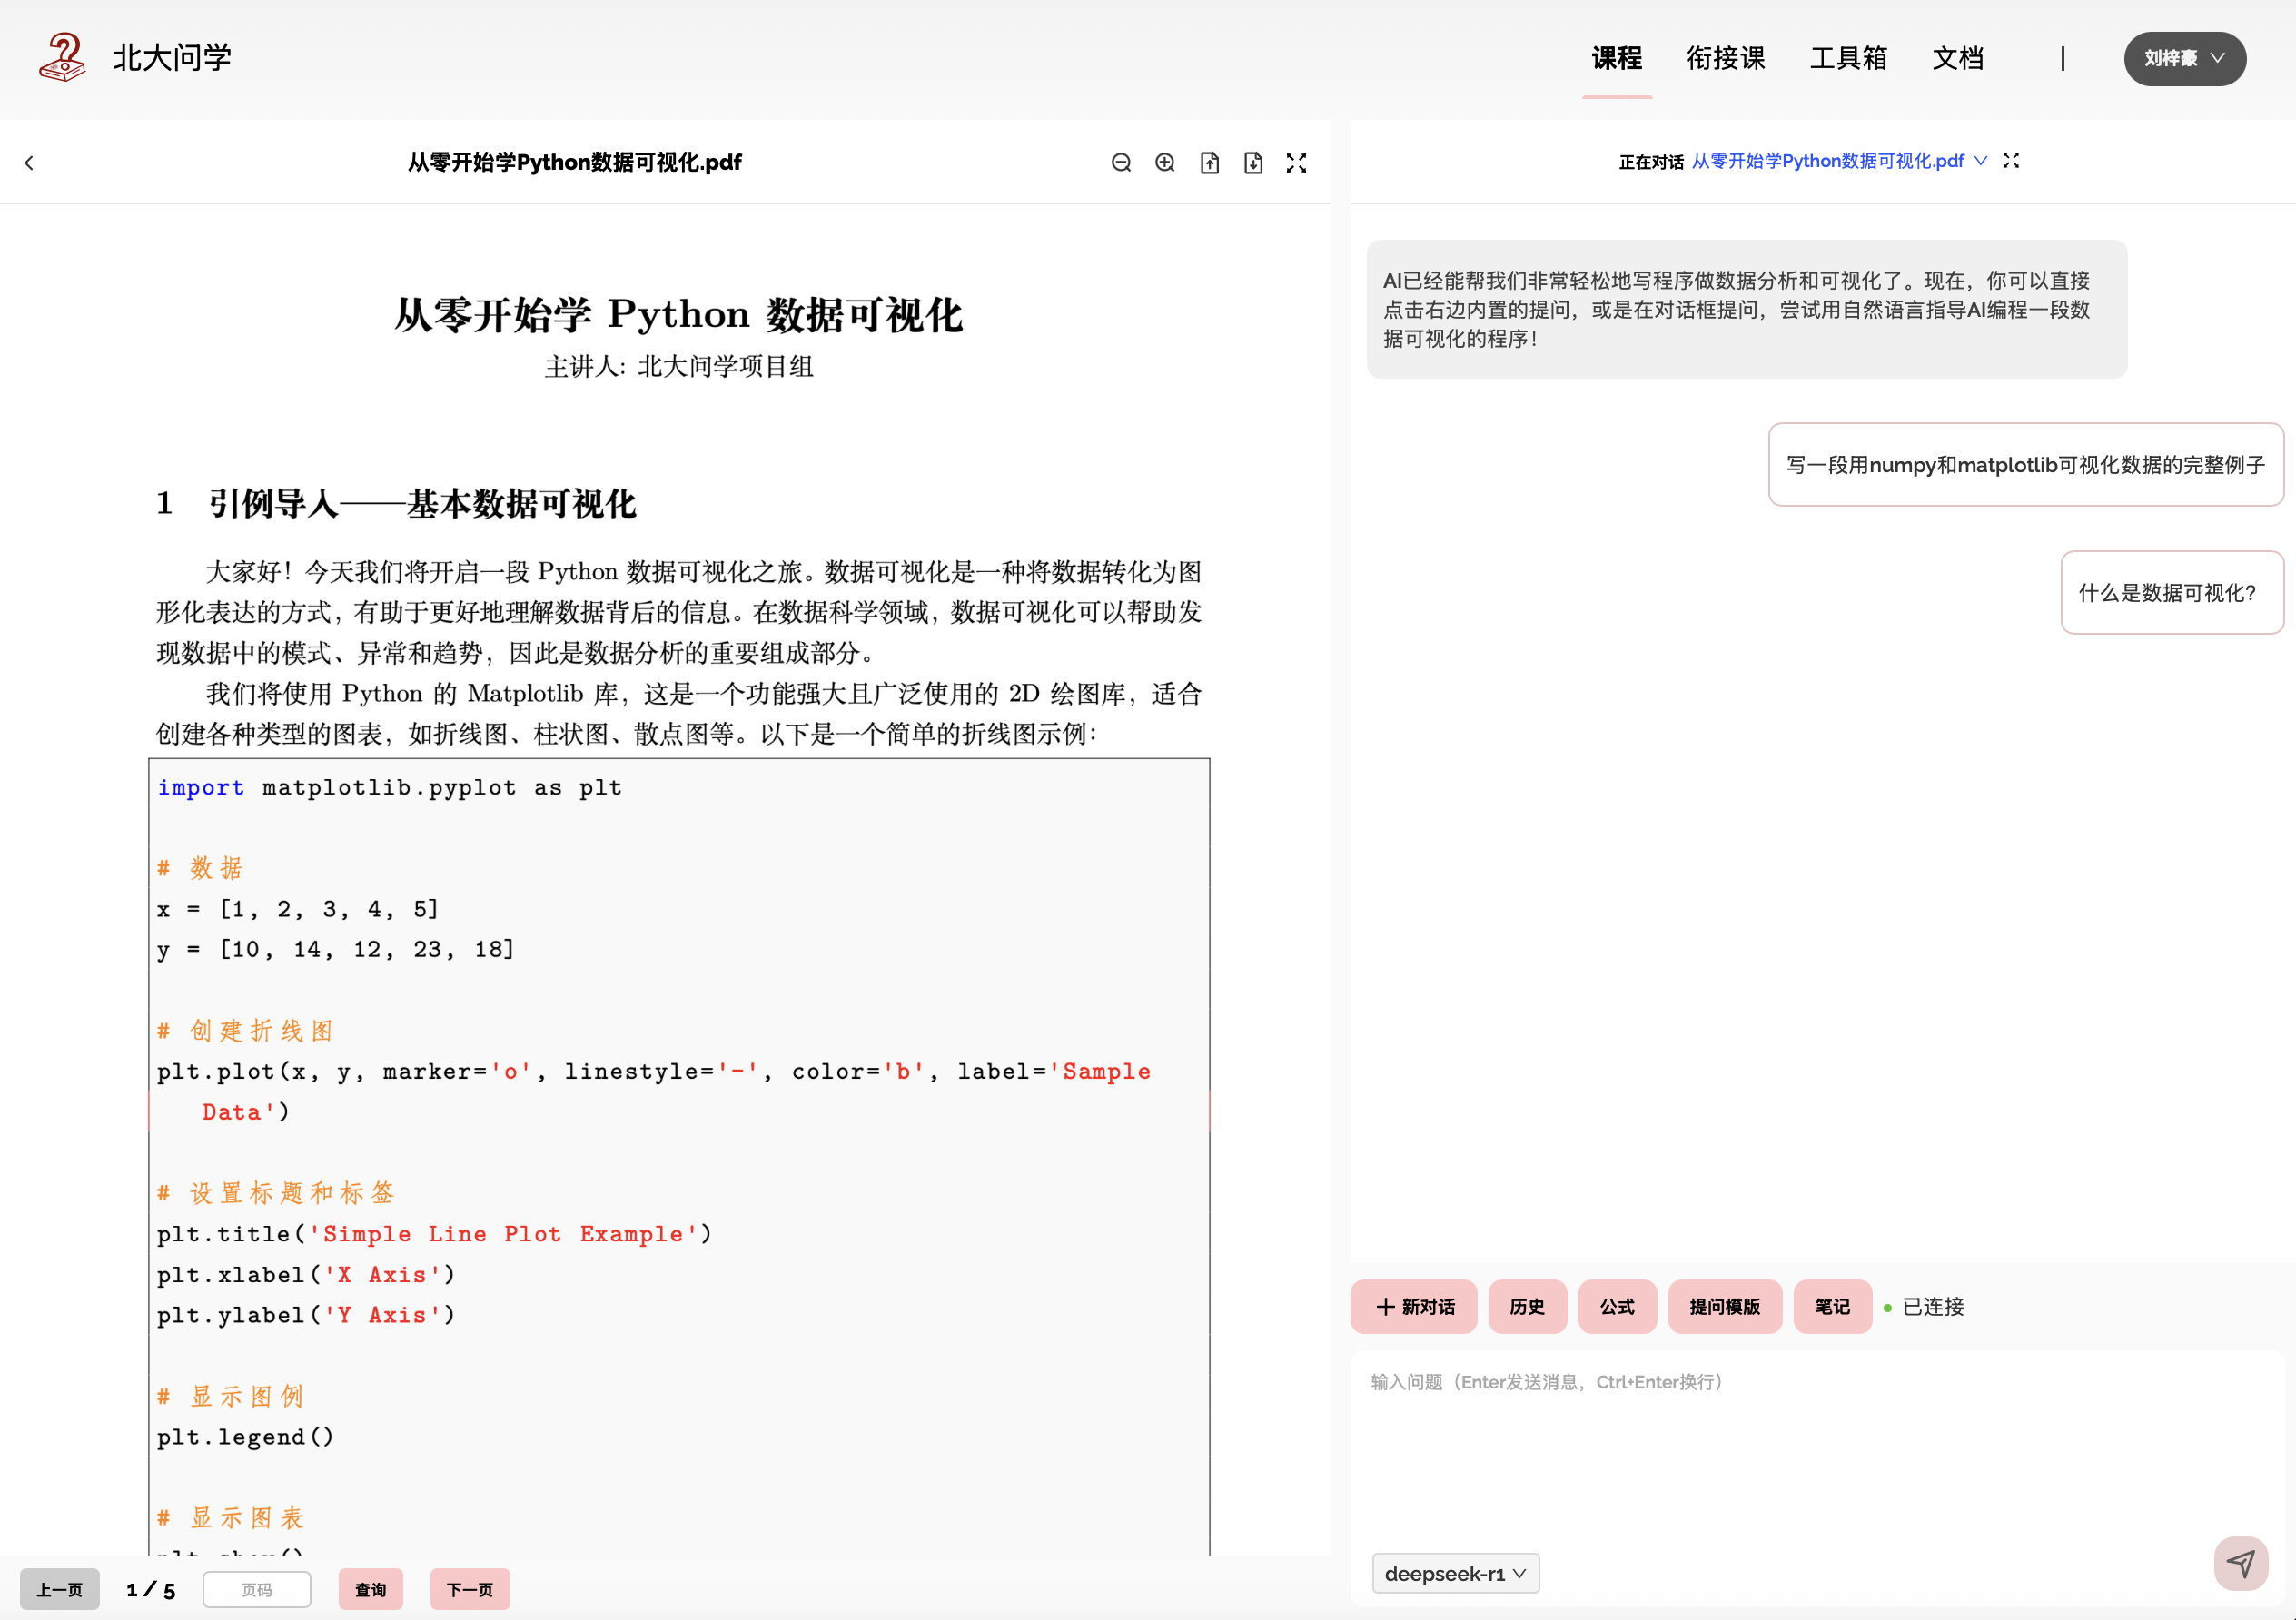
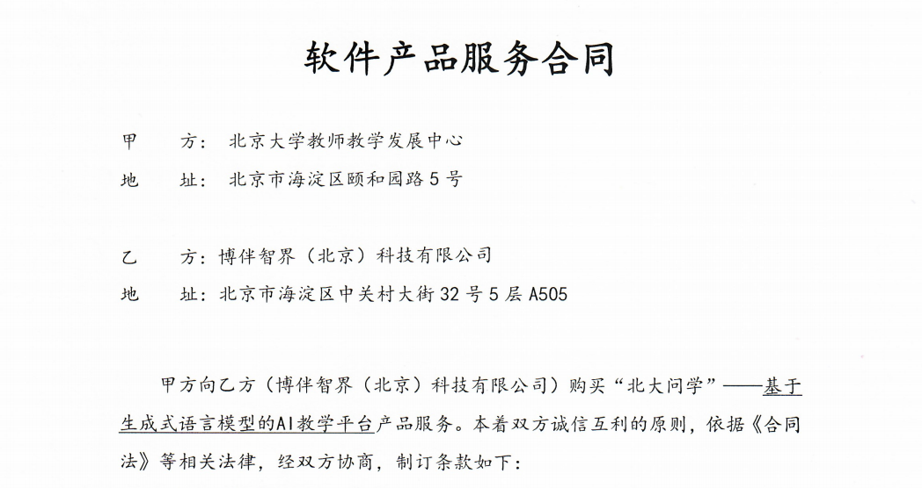
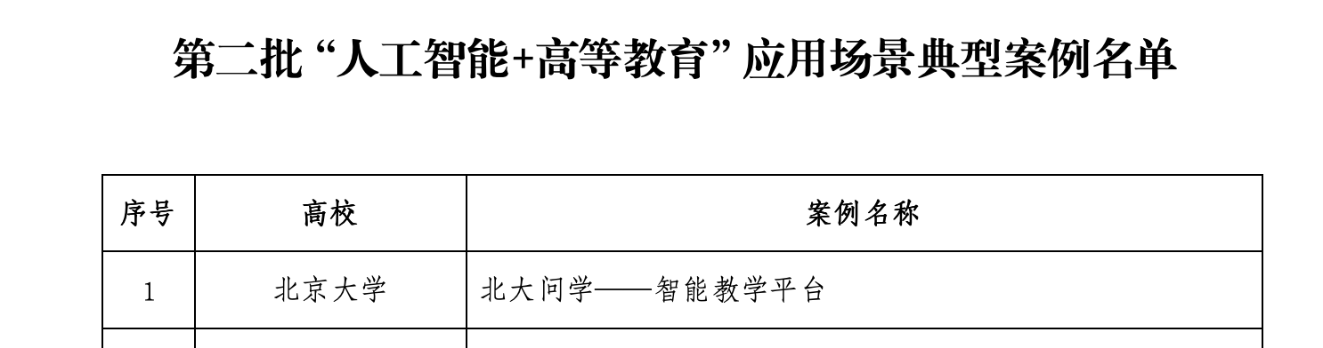
Project Milestones
October–December 2024: Co-developed PKU Quest with Center for Faculty Development,
selected by China Education Ministry as a model case in “AI + Higher Education” initiatives.

Slide 5

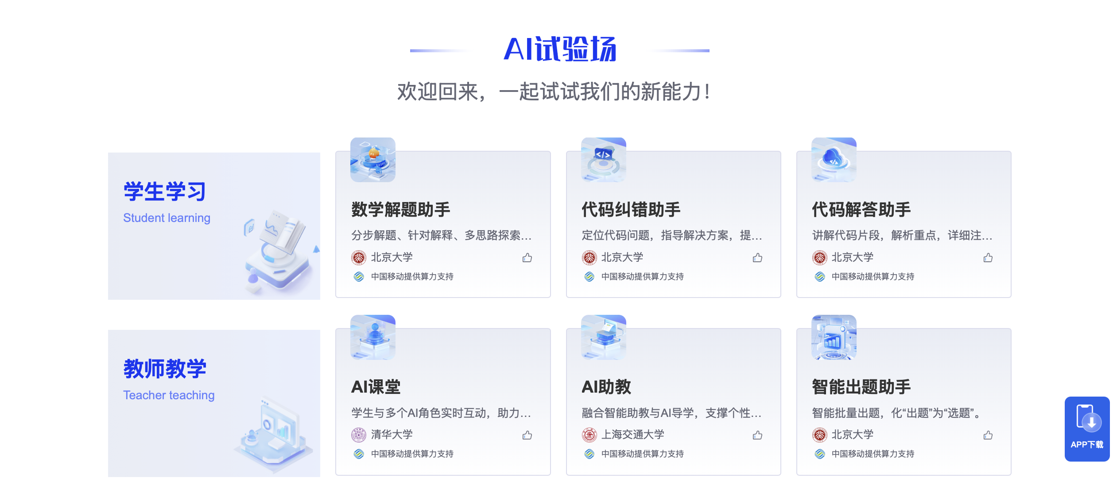
Project Milestones
March 2025: PKU Quest launched math&teaching plugin and was selected for the Ministry of Education’s National Smart Platform AI Model Pilot.

Slide 6
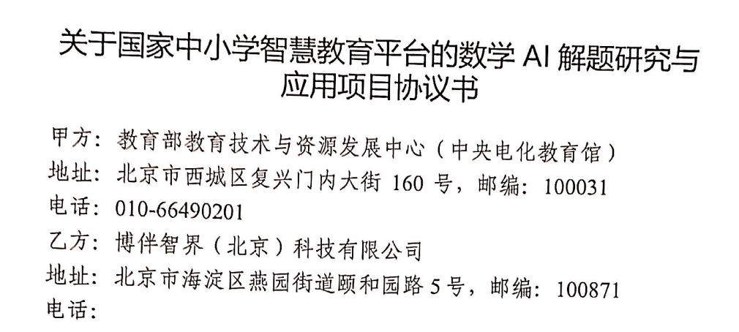
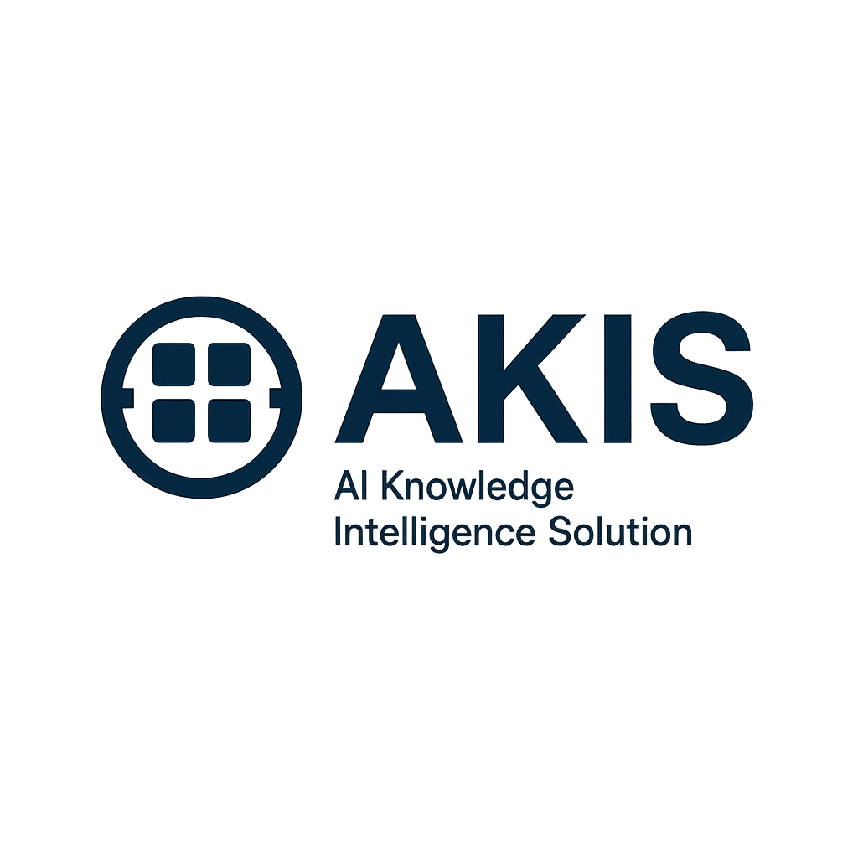


Project Milestones
May 2025 – Present: Partnered with leading universities (PKU, Fuyao University of Science and Technology, and Zhongguancun Academy), joined the Ministry of Education’s AI Q&A project and introduced the comprehensive AI Knowledge Intelligence Solution (AKIS)

Slide 7
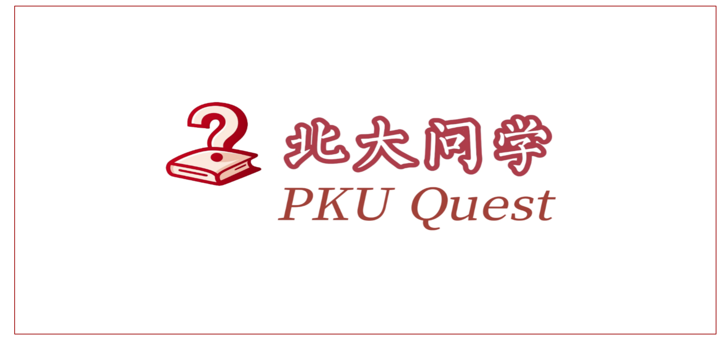
Early Practice of PKUQuest
For teachers: AI teaching tools for syllabus design and question generation.
For students: Knowledge-base Q&A based on lecture notes

Slide 8



From Knowledge-base Chat to Subject-specific AI Agents
Evolves from
student feedback
PKUQuest
LLM-based AI teaching platform
(knowledge-base chat)
Heuristic, interactive tool
for textbook exercises
(Socratic, step-guided)

Slide 9
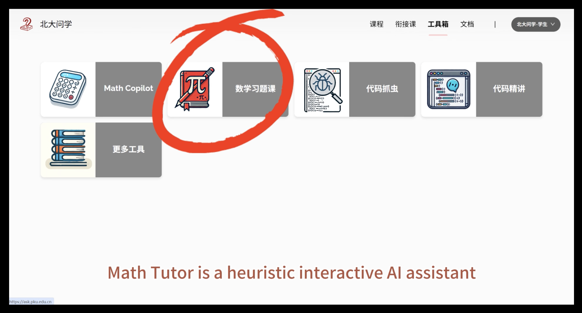
Math Tutor

Slide 10
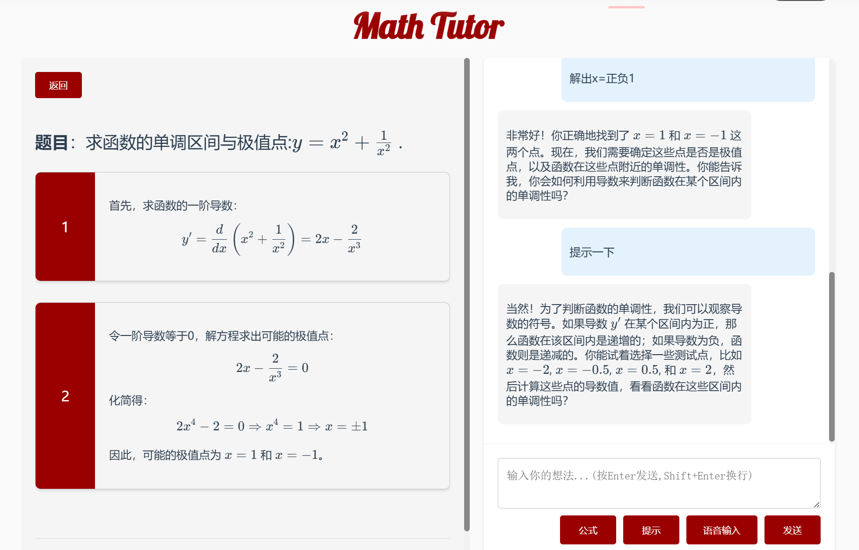
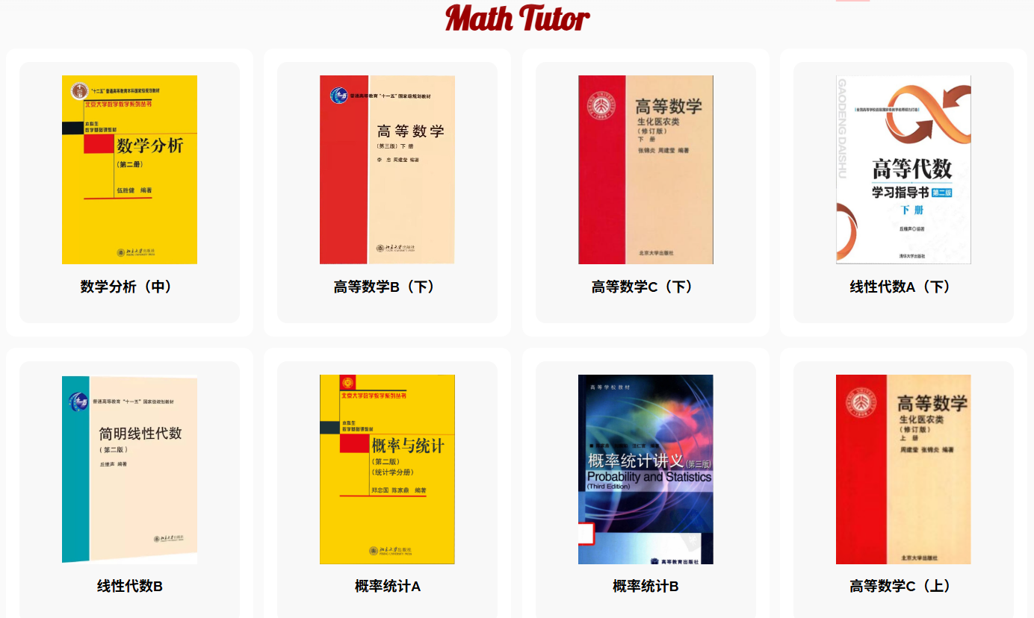
Math Tutor: Hallucination-Free
Heuristic Problem-Solving Assistance
Embedding Human-Annotated Correct Answers— Ensuring Answer Accuracy
Heuristic Guidance— Enabling Students to Solve Independently
"How would you use derivatives to determine the monotonicity of a function on a given interval?"
"Can you try selecting some test points... to check the monotonicity?"

Slide 11
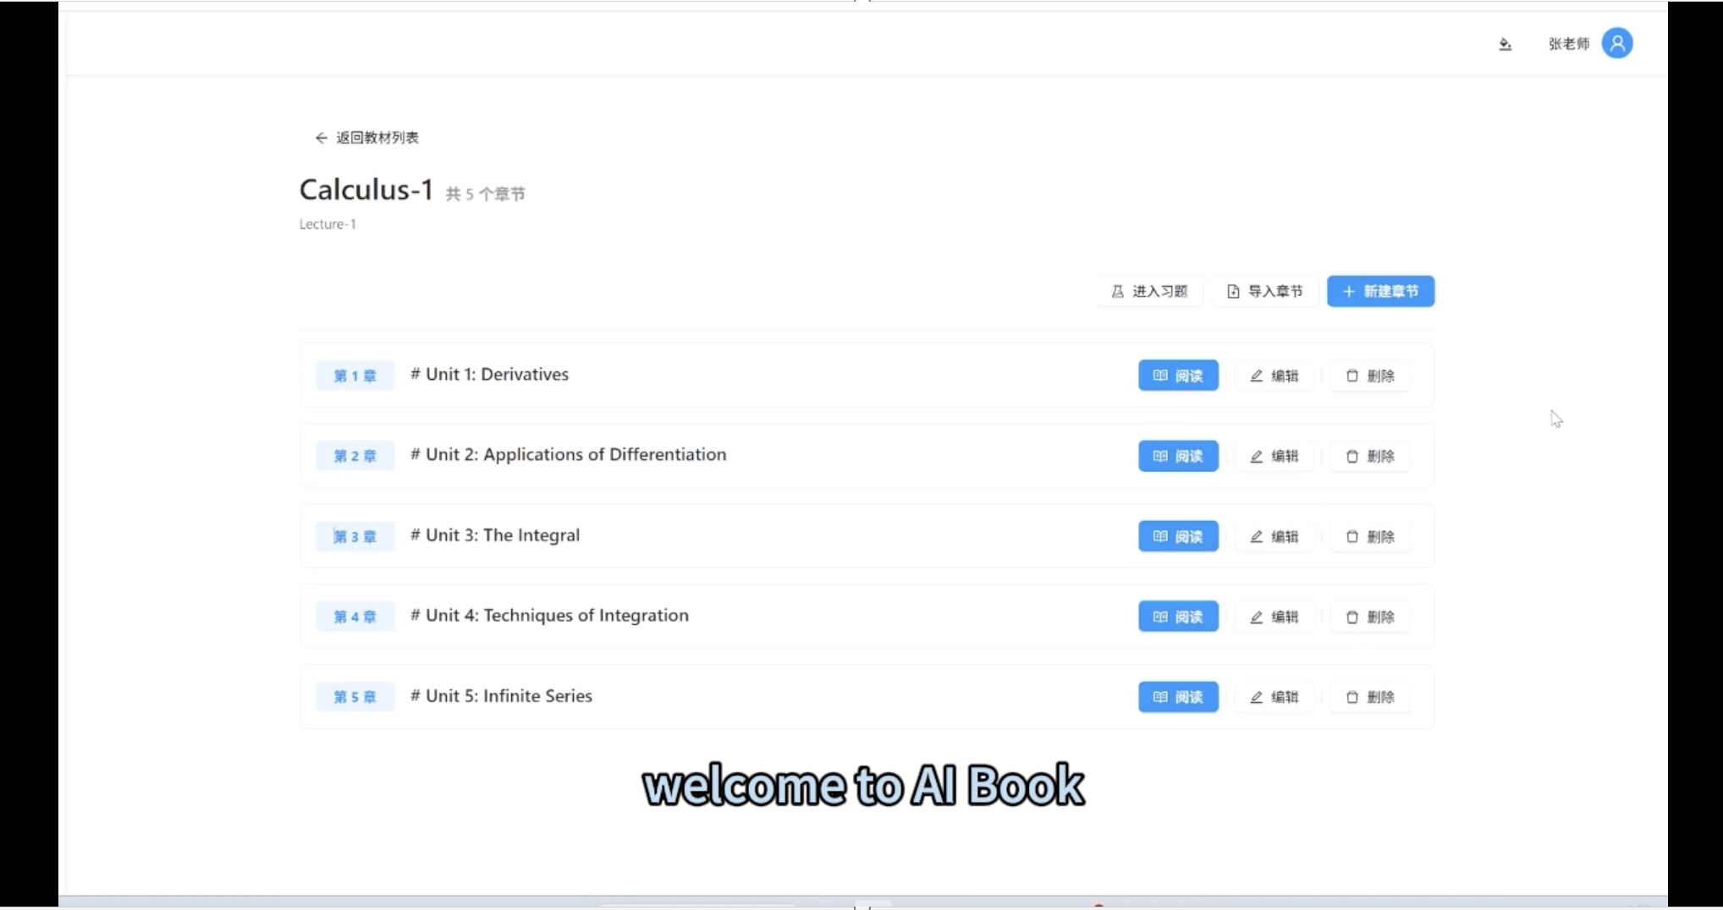
AI-Driven Digital Textbooks

Slide 12
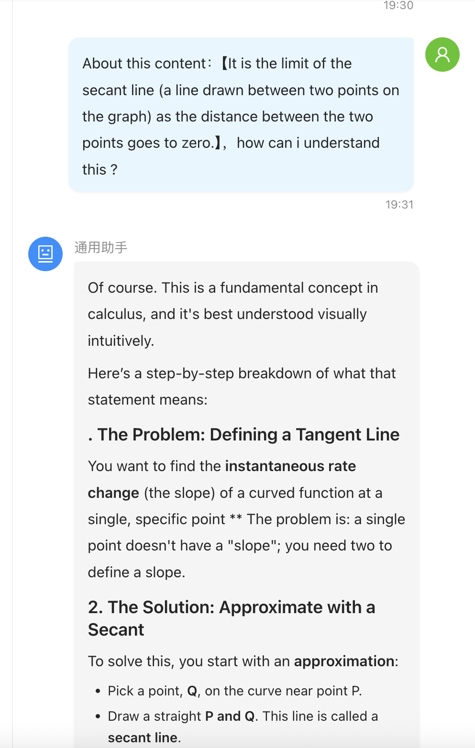
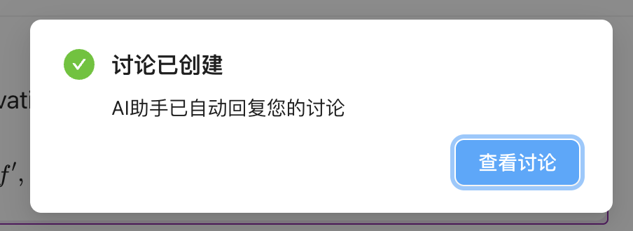
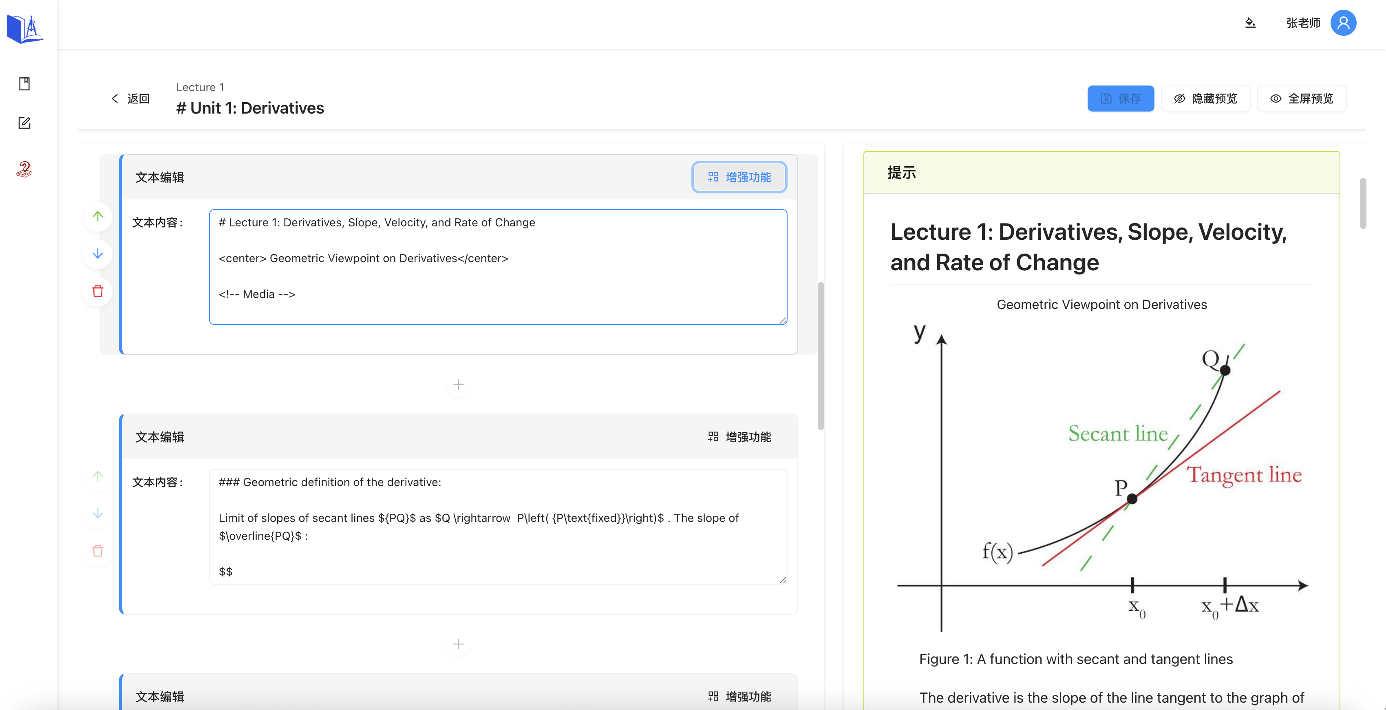
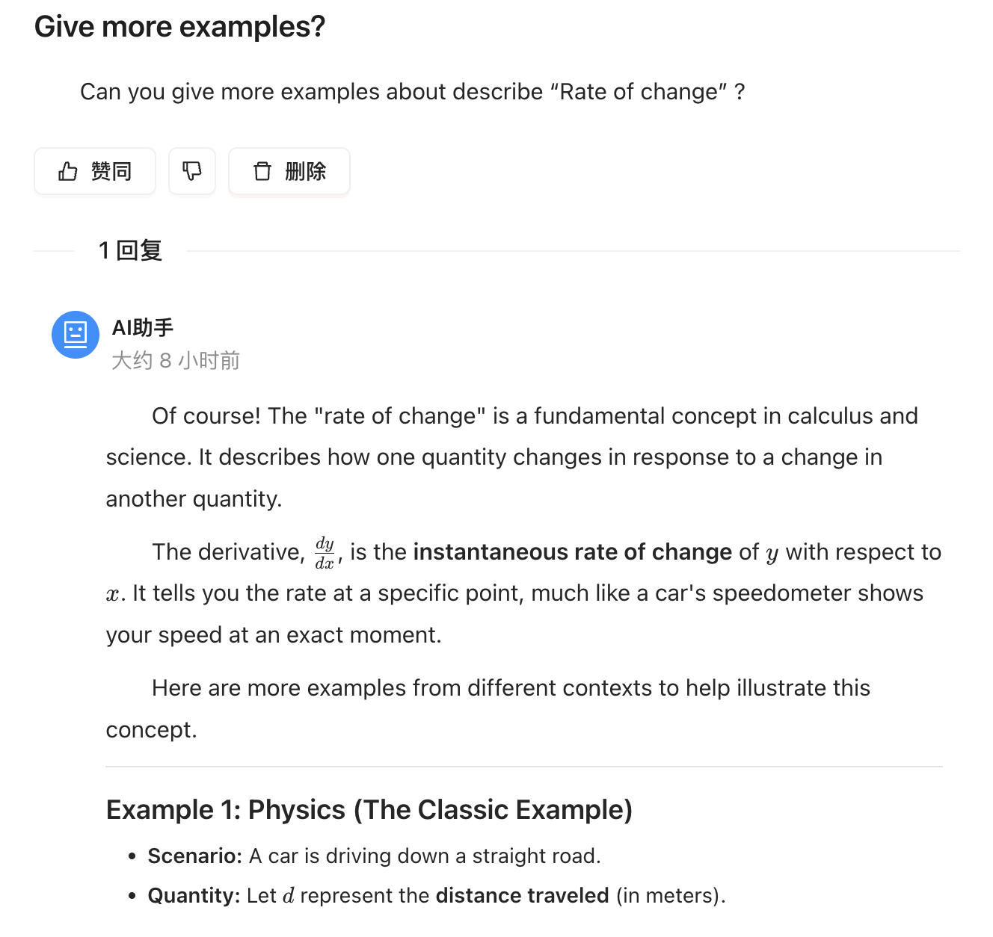
AIBOOKS: A living course material that evolves continuously
🏋️Instructor Contributions: Teachers can update and supplement the latest scientific and technological advances in real time.
🤝Student–AI Collaboration: Students and the AI assistant co-create a discussion community, leaving a traceable record of the course.

Slide 13
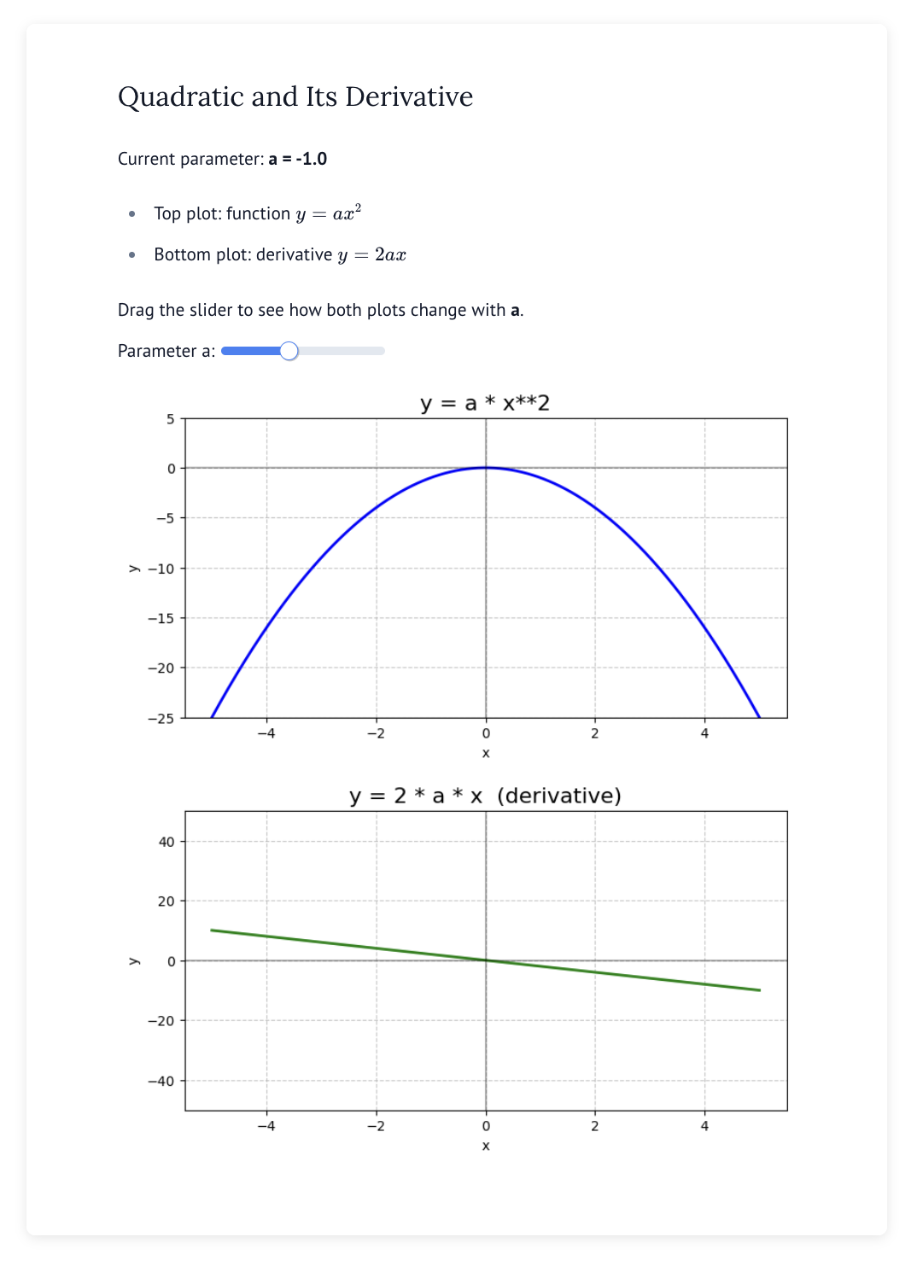
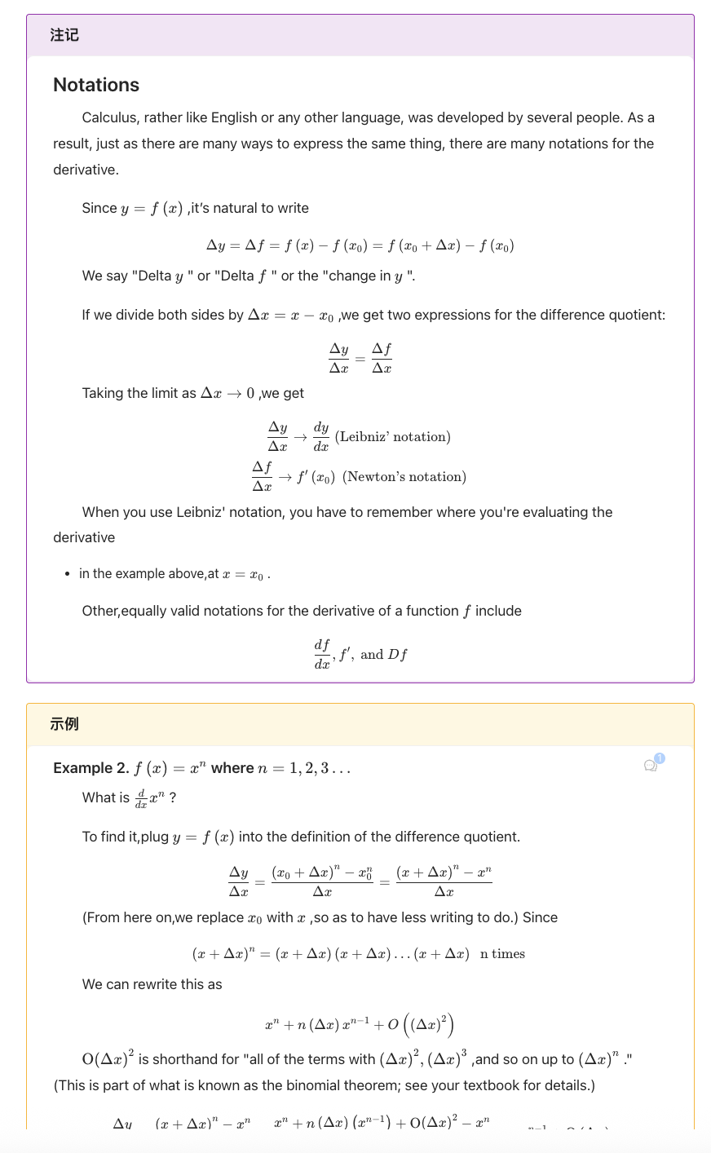
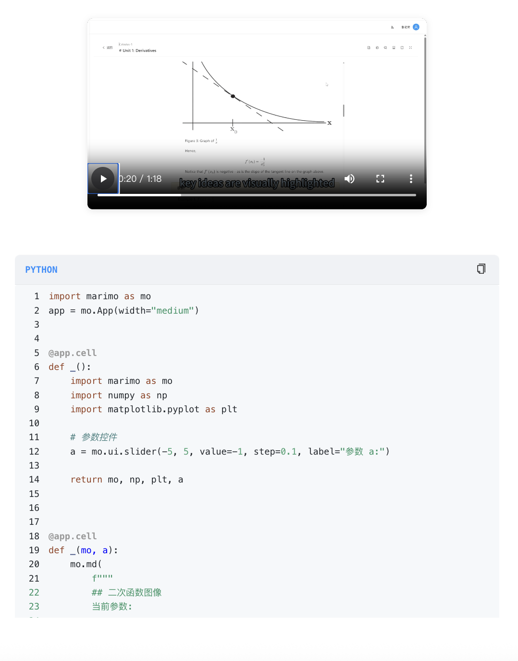
AIBOOKS: A living course material that evolves continuously
🎥 Multimodal Presentation: Seamless support for formulas, images, videos, and code

Slide 14
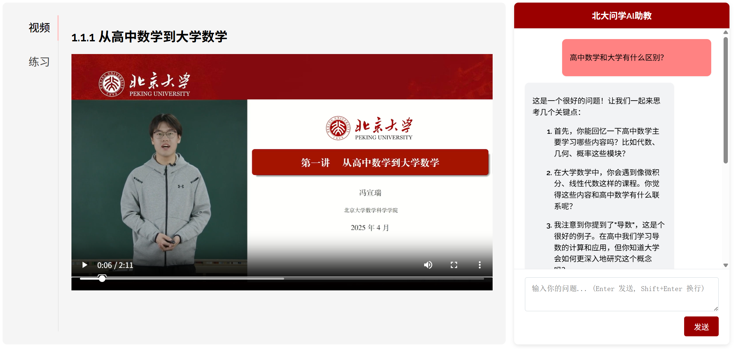
EduBridge: Smart Bridging Courses to Bridge High School and University
Contents (Selected)
Advanced Mathematics Bridging Course
From High School Mathematics to University Mathematics
Equations and Inequalities
Polar coordinates
... ...
Widespread student knowledge gaps
Some students struggle in college due to insufficient high school foundation.
1,066
13,423
freshmen users
completed bridge lessons avg. 12.6 per freshmen Within 10 days

Slide 15
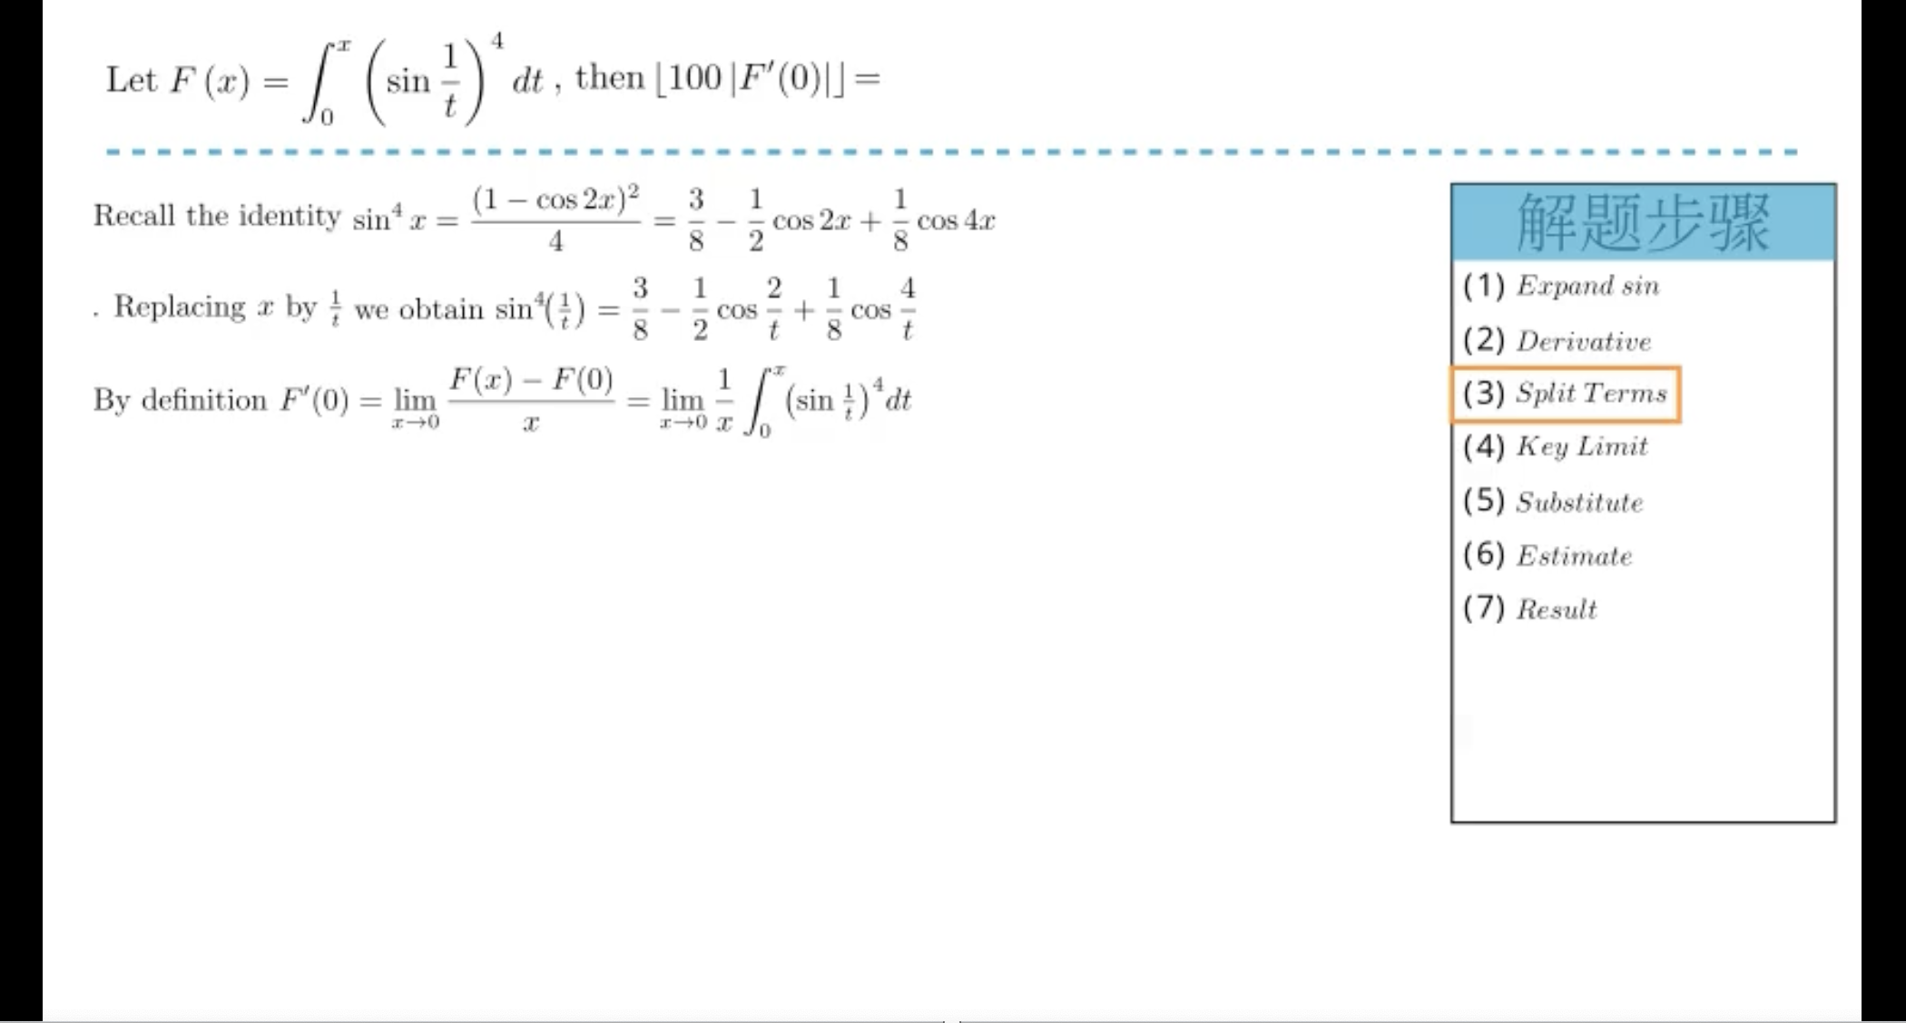
AI-Powered Visual Explanations

Slide 16
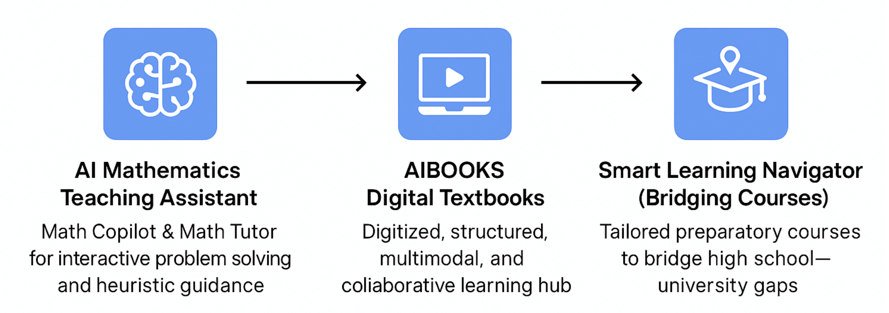
AI Knowledge Intelligent Solution (AKIS) — HK Mathematics Proposal
“Localized for HK foundational courses (e.g., University Mathematics), aligned with teaching style, credit system, and student needs.”

Slide 17
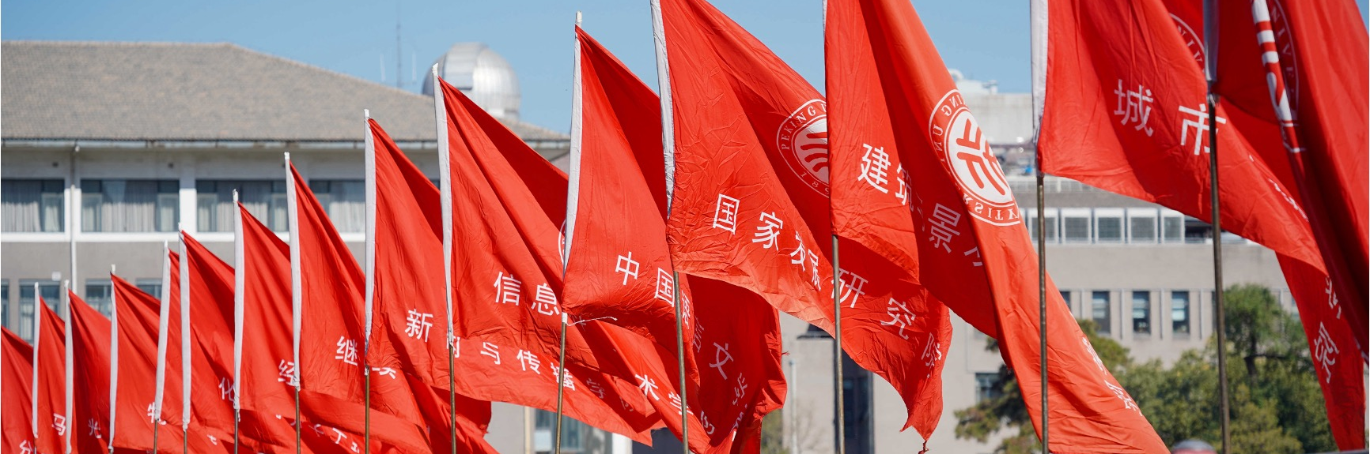

Peking University
Thanks
for
Watching
Company’s Email
business@bbaitutor.com
Zihao Liu：
Tel：（+86）18811428069
Leheng Chen： Tel：（+86）13353396997

